Slide 1
Apple Social Media Analytics for Strategic Branding
Done BY –
SAI SATHYA DHEERAJ SAVARAM
INTERNSHALA DATA SCIENCE COURSE(OCT 15th BATCH)

Slide 2
Contents
Task 1: Data Preprocessing & Cleaning
Task 2: Engagement Analysis
Task 3: Platform Analysis
Task 4: Hashtag & Content Strategy
Task 5: Campaign Effectiveness
Task 6: Follower Retention & Loyalty
Task 7: Summarizing Key Findings & Recommendations

Slide 3
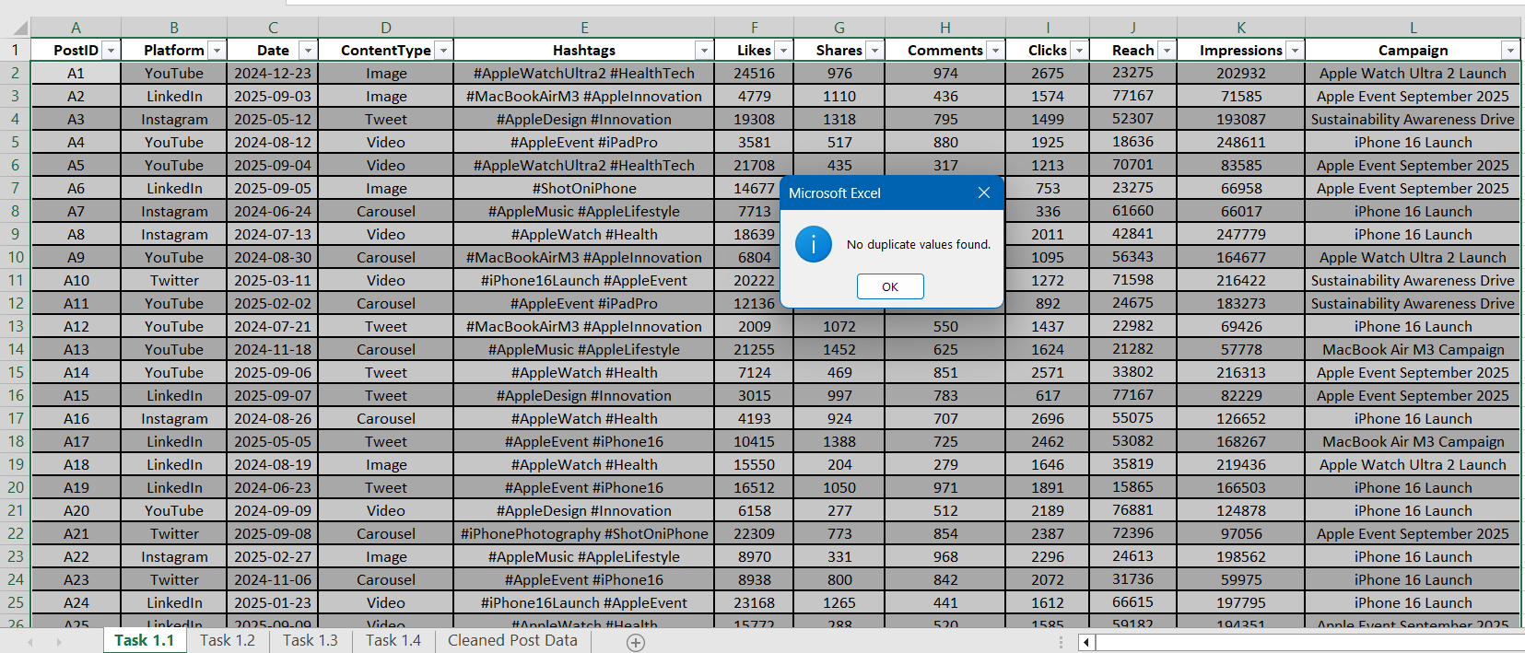
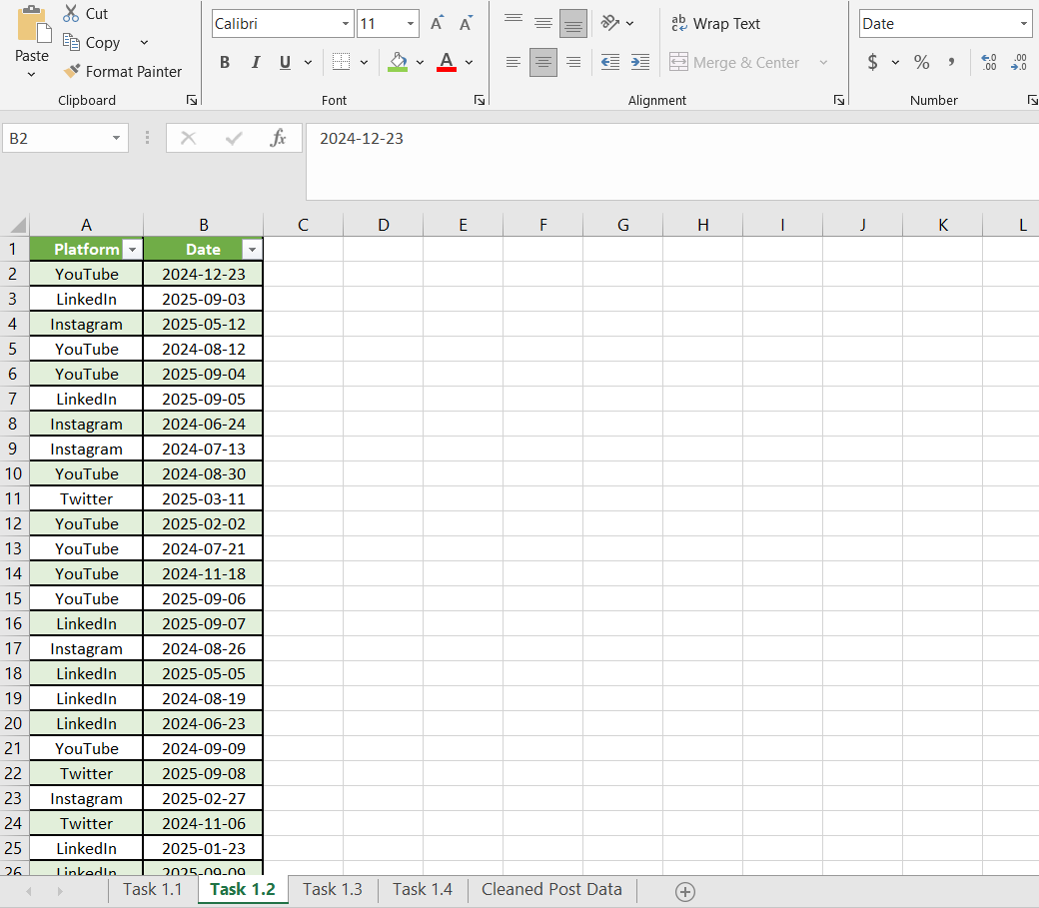
Task 1: Data Preprocessing & Cleaning
Task 1.2
Goal: Standardize date & platform names.
Findings:
    Platform names are already clean
    Dates standardized using date format
Task 1.1
Goal: Remove duplicate Apple posts.
Findings:
  No duplicate posts found

Slide 4
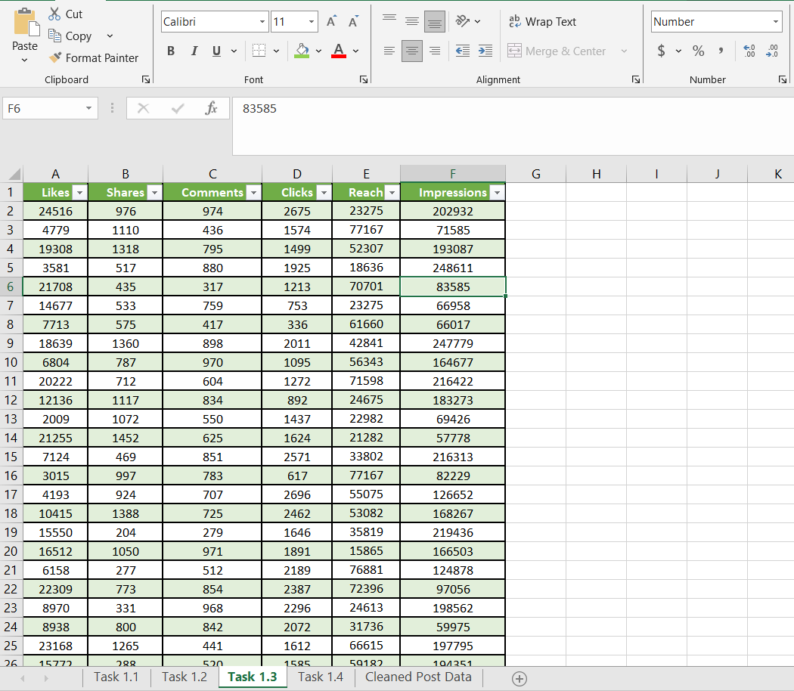
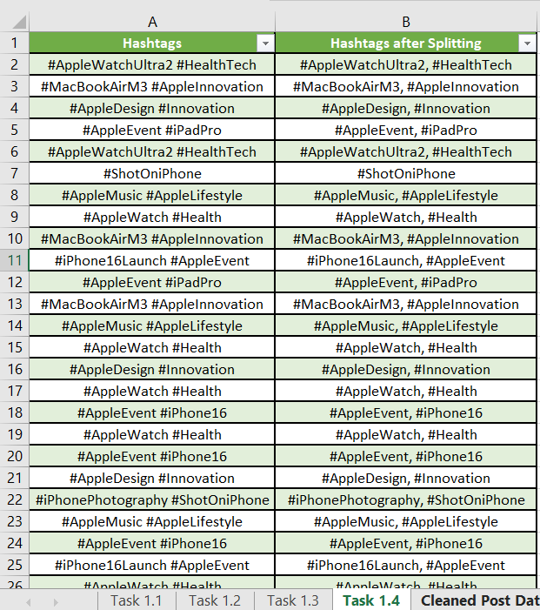
Task 1.3
Goal: Format numeric columns (Likes, Reach, Impressions, Ad Spend).
Approach: Format Numeric columns using number format
Task 1.4
Goal: Split hashtags (e.g., #ShotOniPhone, #iPhone16, #AppleEvent) into separate tags for analysis.
Approach: Split hashtags into separate tags using find and replace

Slide 5
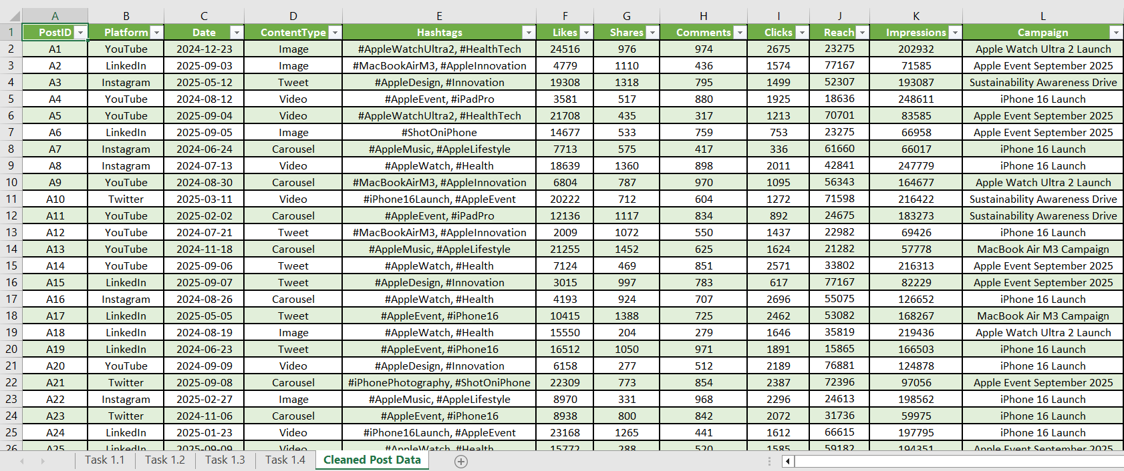
Cleaned Posts Data

Slide 6
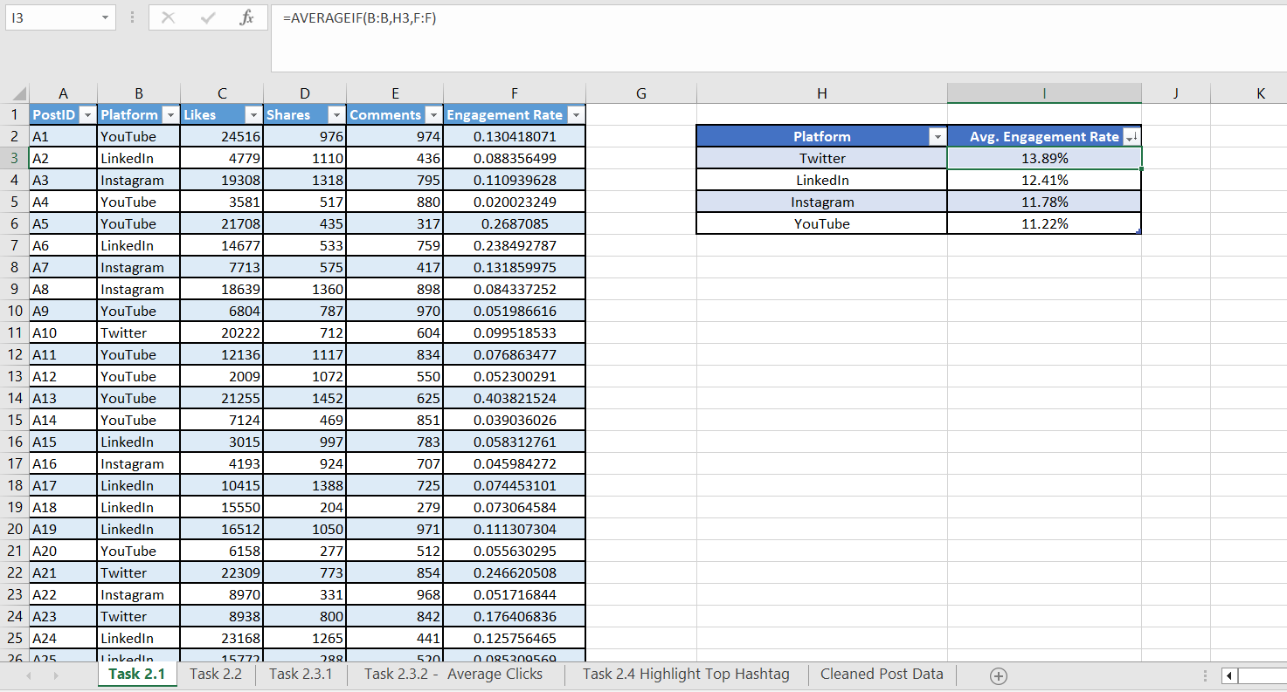
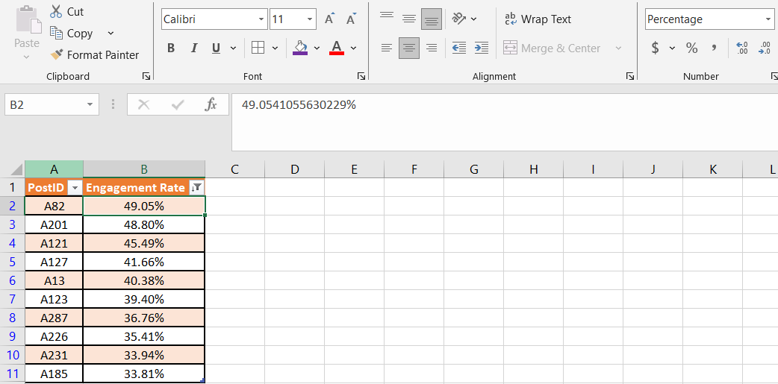
Task 2: Engagement Analysis
Task – 2.1
Goal: Calculate average engagement rate per platform
Approach:
    Calculated Engagement Rate by using the given formula:
    Engagement Rate = Likes+ Shares+ Comments/Impressions
    To calculate Avg. Engagement Rate
  =AVERAGEIF(B:B,E3,C:C)
  Where Column B = Platform, E3 = Twitter(Criteria),
  Column C = Engagement Rate( average_range)
Findings: Twitter has the highest engagement rate
Task - 2.2
Goal: Identify the Top 10 Apple posts with the highest engagement.
Approach:
  Sorted by Engagement Rate( Largest to Smallest)
  Took Top 10 posts with the highest engagement rate
Findings: PostID ->A82 has the highest engagement rate among the top 10 posts.

Slide 7
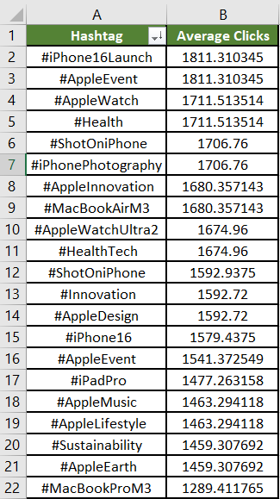
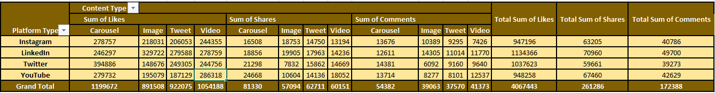
Task 2.3.1
Goal: Show Total Likes, Shares, Comments by Content Type & Platform
Approach:
  Used pivot table on cleaned post data
  Rows -> Platform
  Column -> Content Type
  Values-> Sum of Likes, Sum of Shares, Sum of comments
Task 2.3.2
Goal: Show Average Clicks per post by Hashtag
Approach:
  Used Power Query to group to only the required columns
  Loaded them as a pivot table in Excel
    Rows -> Hashtag
    Values -> Average Clicks
  Sorted by Average Clicks ( largest to smallest)

Slide 8
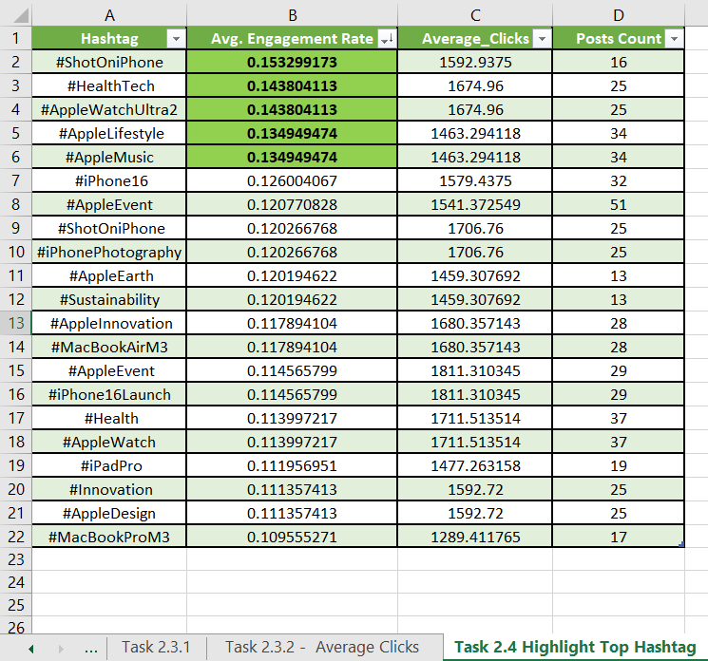
Task - 2.4
Goal: Highlight top-performing hashtags such as #ShotOniPhone, #AppleEvent, #iPhone16Launch, #MacBookAir.
Approach:
  Used Power Query to group to only the required columns
  Loaded them as a table in Excel
  Sorted by engagement rate ( largest to smallest )
  Highlighted the top 5 performing hashtags by engagement rate using conditional formatting
Findings:
  Top 5 performing hashtags are
    #ShotOniPhone
    #HealthTech
    #AppleWatchUltra2
    #AppleLifestyle
    #Apple Music

Slide 9
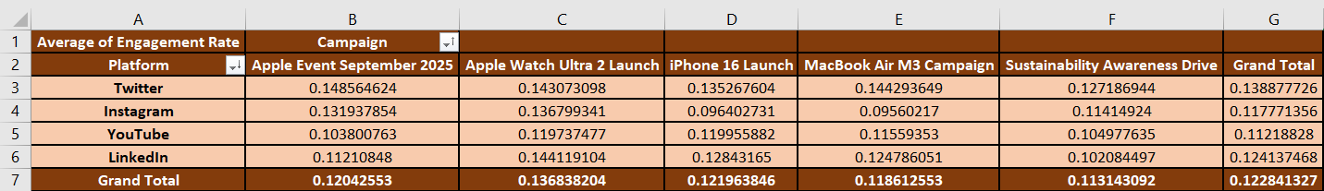
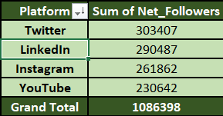
Task 3: Platform Analysis
Task – 3.2
Goal: Compare follower growth rates across platforms.
Approach:
  Added a new column named as Net_followers in Engagement Summary
  Calculated using formula:
  Net_followers = New Followers- Unfollows
  Used Pivot table on Engagement Summary:
    Rows -> Platform
    Values -> Sum of Net_followers
Findings: Twitter has the highest follower growth
Task – 3.1
Goal: Identify the platform with the highest engagement (e.g., Twitter for announcements vs. YouTube for product demos).
Approach:
  Used Pivot table on Cleaned Post Data
  Rows -> Platform
  Column -> Campaign
  Values -> Avg. Engagement Rate
Findings: Twitter has the highest engagement rate

Slide 10
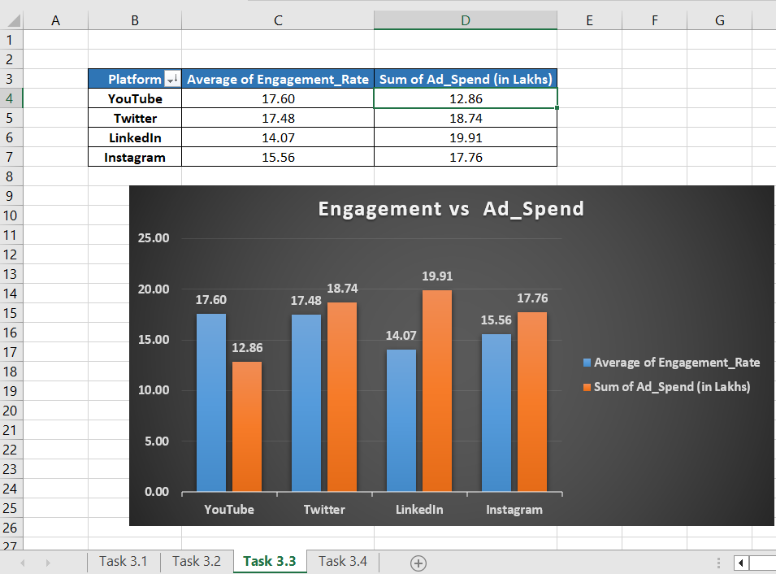
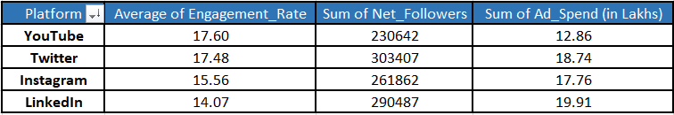
Task – 3.3
Goal: Visualize Engagement vs. Ad Spend per platform.
Approach:
  Used pivot table on Engagement Summary Data:
  Rows -> Platform
  Values -> Avg.Engagement Rate
  Sum of Ad_Spend(in Lakhs)
Task – 3.4
Goal: Advise Apple’s team: Should they focus on YouTube + Instagram (videos + visuals) or continue a multi-platform strategy?
Recommendation:
  Focus more on Instagram & YouTube
  Maintain multi-platform presence for reach

Slide 11
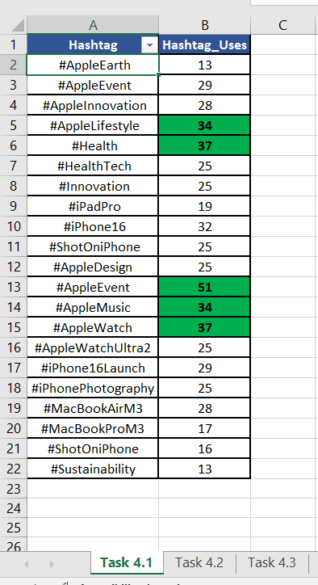
Task 4: Hashtag & Content Strategy
Task – 4.1
Goal: Identify the most frequently used Apple hashtags.
Approach:
  Used Power Query to get the cleaned Posts Data
  Inserted Pivot Table on grouped columns from Power Query
  Rows -> Hashtag
  Values-> Hashtag_Uses (Posts Count)
Findings:
    Most frequently used Apple Hashtags are:
    #AppleEvent, #AppleWatch, #Health,#AppleLifestyle, #AppleMusic

Slide 12
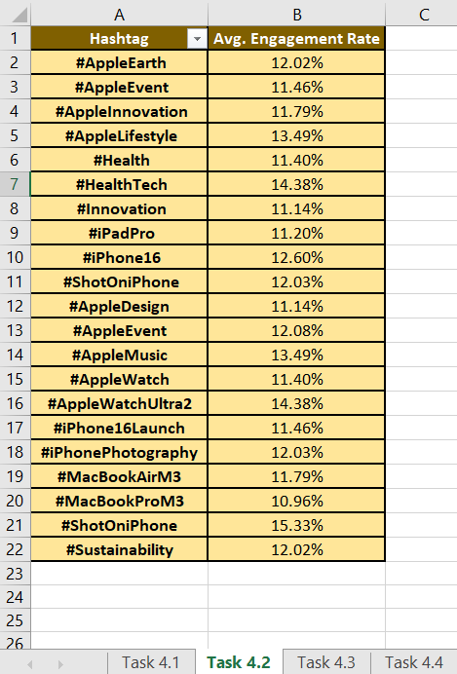
Task – 4.2
Goal: Compare the average performance of posts containing each hashtag.
Approach:
  Used Power Query to get the cleaned Posts Data
  Inserted Pivot Table on grouped columns from Power Query
  Rows -> Hashtag
  Values-> Average Engagement Rate

Slide 13
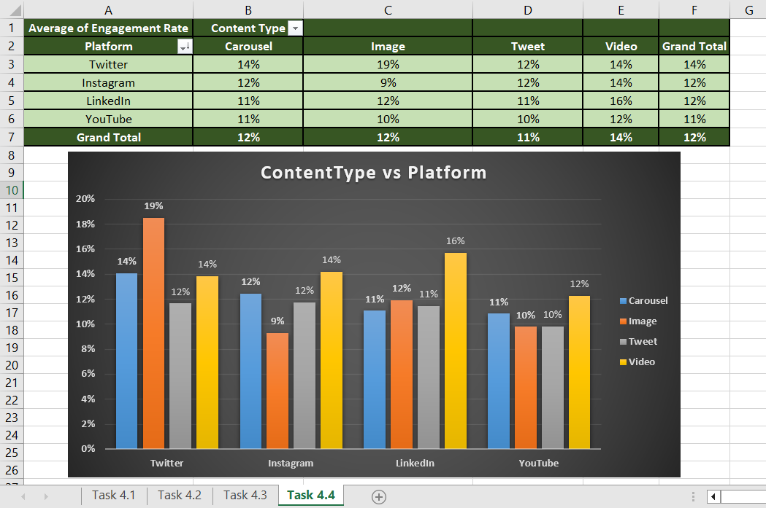
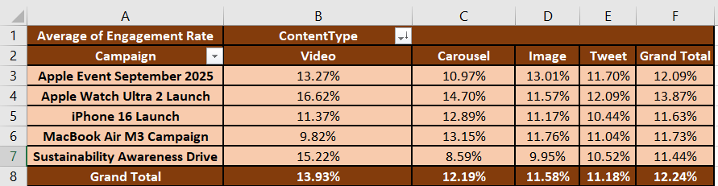
Task – 4.3
Goal: Compare content performance:
  ○ Videos (launch events, ads, product demos)
  ○ Images (product close-ups, lifestyle shots)
  ○ Carousels (feature highlights, comparisons)
Approach:
  Used Pivot Table:
    Rows -> Campaign
    Column -> Content Type
    Values -> Avg. Engagement Rate
Task – 4.4
Goal: Recommend which content type performs best on each platform(e.g., videos for YouTube, product images for Instagram).
Approach:
  Used Pivot Table:
    Rows -> Campaign
    Column -> Content Type
    Values -> Avg. Engagement Rate
Recommendation:
  Videos work best on YouTube, images on Instagram, and carousels on LinkedIn.

Slide 14
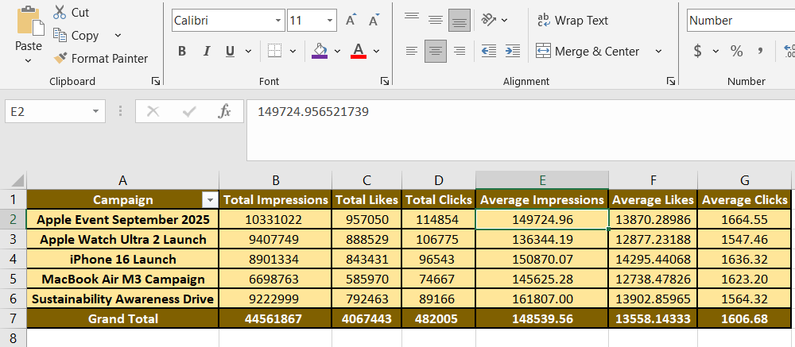
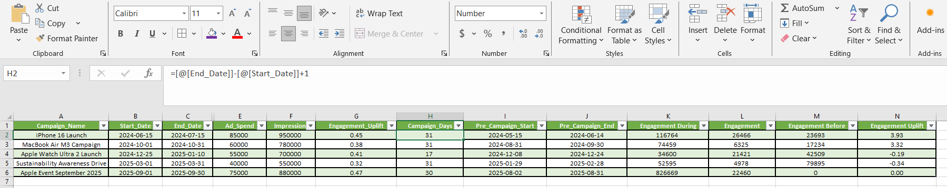
Task 5: Campaign Effectiveness
Task – 5.1
Goal: Calculate the Total & Average Impressions, Likes, and Clicks per Campaign.
Approach:
  Used pivot table:
    Rows: Campaign
    Values: Total Impressions, Total Likes, Total Clicks
        Average Impressions, Average Likes, Average Clicks
Task - 5.1.2
Goal: Measure engagement uplift during vs. before campaigns (e.g., iPhone 16 launch spike).
Approach:
Campaign Days = End Date – Start Date + 1
Pre-Campaign Start = Start Date – Campaign Days
Pre-Campaign End = Start Date - 1
Engagement During =SUMIFS(Posts!$M:$M, Posts!$L:$L, $A2,Posts!$C:$C, ">=" & $B2,Posts!$C:$C, "<=" & $C2)
where M= Engagement, L= Campaign(Posts), A2= Campaign,
C = Date(Posts),B2= Start_Date, C2 = End_Date

Slide 15
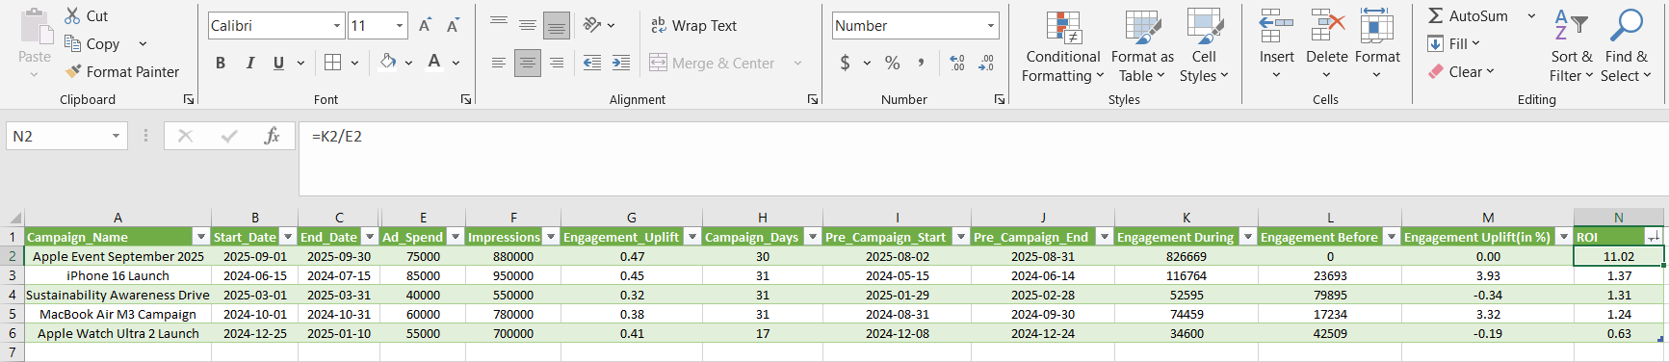
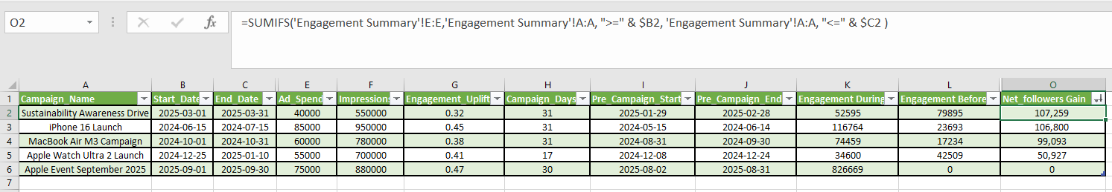

Task – 5.2.1
Goal: Which campaign had the highest ROI (engagement vs. spend)?
Approach:
    Calculate ROI by using this formula:
      R$OI=\frac{Engagement During−Engagement Before}{Engagement Before}$
    Formula:
      =IF(L2=0, 0, ((K2-L2)/L2))
      Where L2 = Engagement Before K2 = Engagement During
    Sort by Largest to Smallest
Findings:
  Apple Event September 2025 campaign has highest ROI with 11.02
Task - 5.2.2
Goal: Which campaign drove the strongest follower growth?
Approach:
  In the engagement Summary, calculate Net_ follower gain by: Net follower gain = New followers – Unfollows
  Formula:
=SUMIFS('Engagement Summary'!E:E,'Engagement Summary'!A:A, ">=" & $B2, 'Engagement Summary'!A:A, "<=" & $C2 )
Where Column E = Net_follower_gain (Engagement Summary)
Column A = Weekly Start Date(Engagement Summary)
B2 = Start Date, C2 = End Date
  Sort by Largest to Smallest
Findings:
  Sustainability Awareness Campaign has the strongest follower growth with 107,259

Slide 16
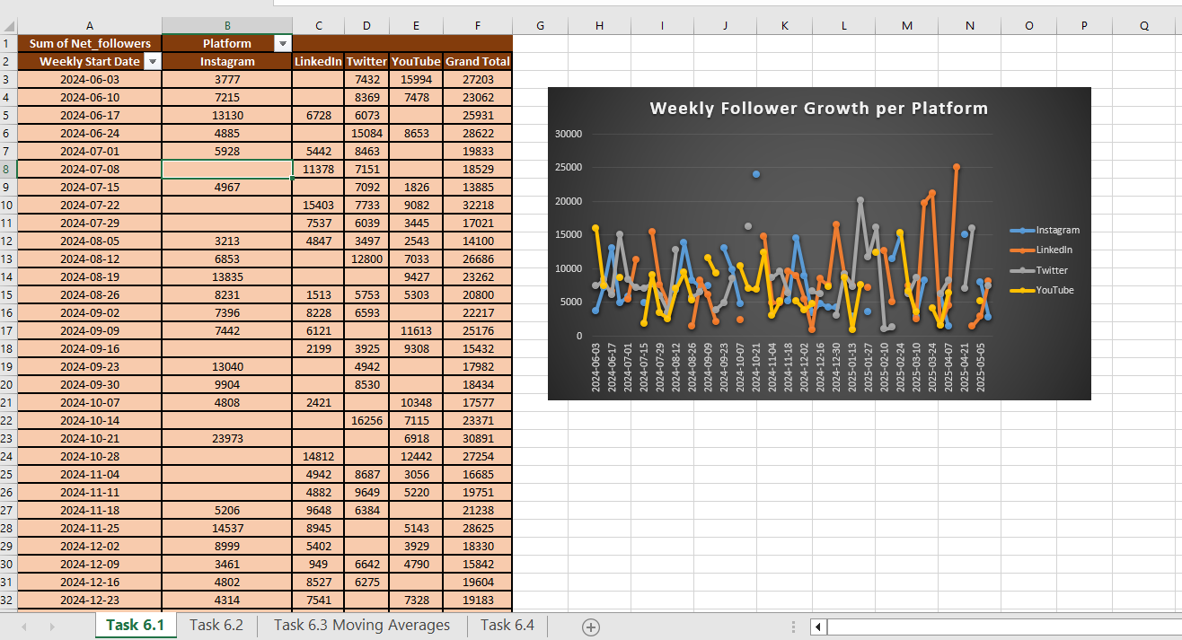
Task 6: Follower Retention & Loyalty
Task – 6.1
Goal: Visualize weekly follower growth per platform (line chart).
Approach:
    Used Engagement Summary
    Insert Pivot Table:
      Rows: Weekly Start Date
      Columns: Platforms
      Values: Net_followers

Slide 17
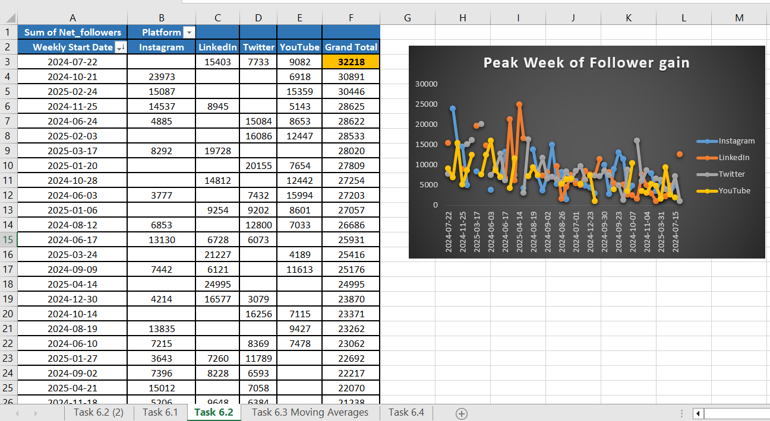
Task – 6.2
Goal: Identify the peak week of follower gain.
Approach:
    Used Engagement Summary
    Insert Pivot Table:
      Rows: Weekly Start Date
      Columns: Platforms
      Values: Net_followers
    Sort by Largest to Smallest
Findings:
  2024-07-22 is the peak week of follower gain

Slide 18
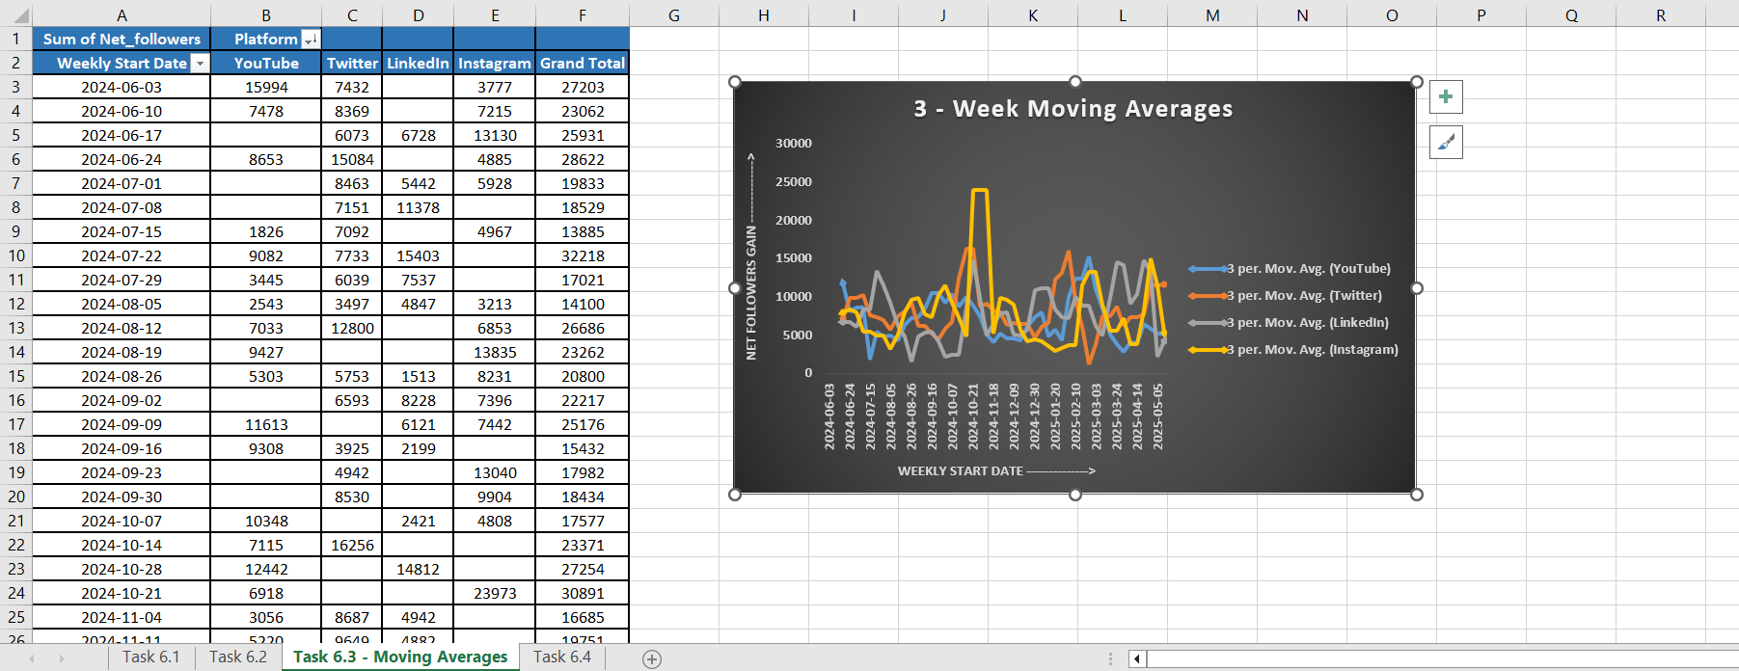
Task – 6.3
Goal: Use moving averages to smooth growth trends.
Approach:
    Used Engagement Summary
    Insert Pivot Table:
      Rows: Weekly Start Date
      Columns: Platforms
      Values: Net_followers
Findings:
  Using a 3-week moving average smooths out short-term spikes and shows the underlying follower-growth trend more clearly.

Slide 19
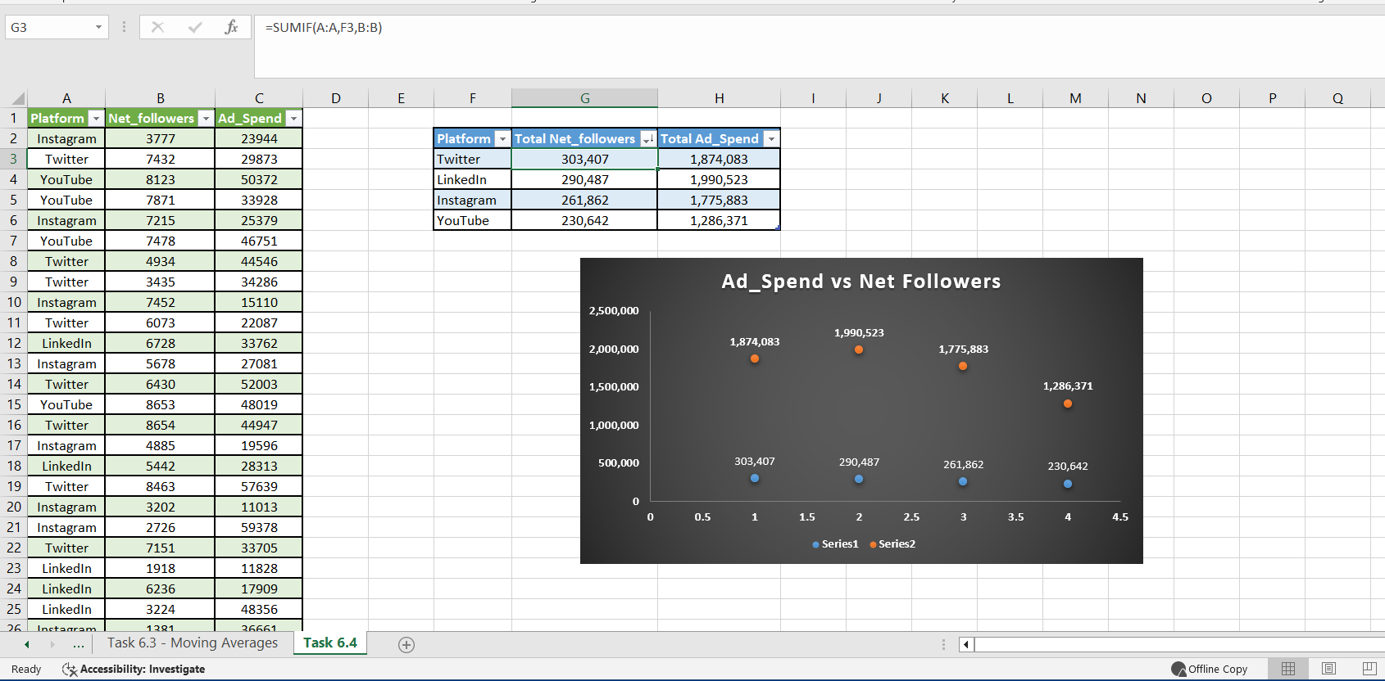
Task – 6.4
Goal: Correlate ad spend vs. follower growth using scatter plots.
Approach:
    Removed Duplicates from the platform column
    Calculate total Net_followers by using this formula:
      =SUMIF(A:A,F3,B:B)
      Where, Column A = Platform
      F3 = Instagram(Criteria)
      Column B = Net_followers(Sum Range)
    Similarly, calculate total Ad_Spend by using this formula:
        =SUMIF(A:A,F3,C:C)
        Where , Column C = Ad_Spend( Sum Range)
    Here, Series 1: Platform Name, Net_followers
    Series 2: Platform Name, Ad_Spend Value
Findings:
  Twitter generated the highest total follower growth despite having lower ad spend than Instagram and LinkedIn, showing it is the most cost-efficient platform.

Slide 20
Summarizing Key Findings & Recommendations
Key Findings
Instagram and YouTube delivered the strongest engagement, especially for visuals and video content.
Twitter showed the highest follower growth, even with relatively lower ad spend.
Launch campaigns like iPhone 16 caused clear engagement spikes.
Top 5 hashtags (#ShotOniPhone, #HealthTech, #AppleWatchUltra2, #AppleLifestyle, #AppleMusic) consistently boosted post performance.
The 3-week moving average showed a stable upward trend in follower growth.

Slide 21
Summarizing Key Findings & Recommendations
Recommendations
Focus more on Instagram and YouTube, since visual content performs best there.
Use event-based and launch content to capture strong engagement peaks.
Continue using high-performing hashtags for better reach and visibility.
Spend ad budget wisely, increasing spend on platforms that convert to follower growth (e.g., Instagram, Twitter).
Track long-term trends with moving averages to avoid weekly noise.

Slide 22
THANK YOU!

